Slide 1

PROVING AIRLINE SAFETY ERIN HOWLAND DSC640

Slide 2
Media presentation and possible counters
The media is currently touting a decrease in airline safety as fact
Primary ways to measure transportation safety:
Fatalities
Total number of accident/incident types
Counters
Consider comparisons to other modes of transportation
Cars/buses
Trains
Ethical considerations for sourcing and presentation of data
Where was the media’s data sourced vs ours?
What story does the data tell vs how is it being presented?
Potential legalities (e.g. liable, slander, etc.)
Our Sources
https://aviation-safety.net/
https://www-fars.nhtsa.dot.gov/Main/index.aspx

Slide 3
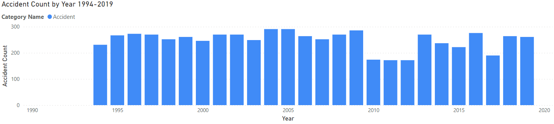
Airline ACCIDENT COUNT 1994-2019
Total number of accidents has stayed relatively stable, though perhaps less predictable since 2010
Still appears to show a general decrease in total number of accidents

Slide 4
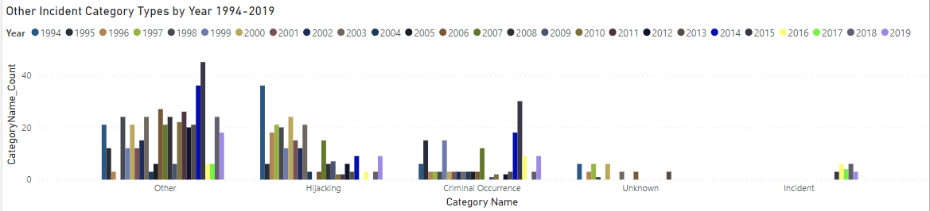
Other incident type counts 1994-2019
Similar pattern to accidents
Far more years recently with no occurrence of these categories occurring

Slide 5
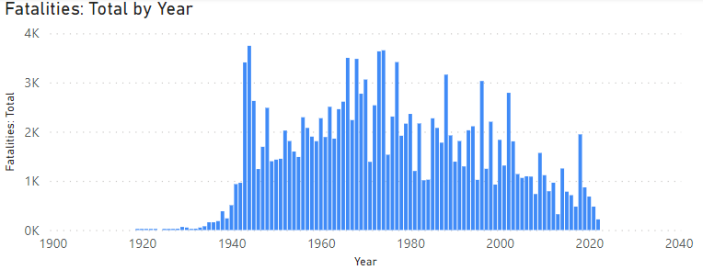
Airline FATALITIES BY THE NUMBERS 1919-2022
Overall decrease of airline fatalities since the mid 1970s
Overall fatalities measured in thousands

Slide 6
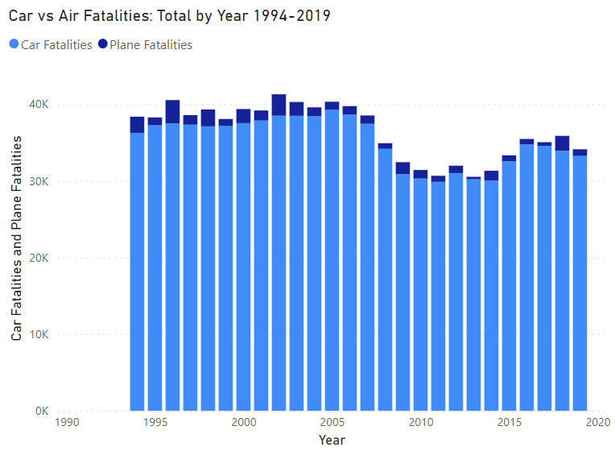
Fatalities: car vs airline 1994-2019

